Slide 1


IoT Using LoRaWAN

Slide 2
Team Introduction
Michael Owczarek
Joel Morran
Luis Shigetomi
James Curnow
Rémi Petit

Slide 3
Team Overview
Field | Team Member(s)
Azure | Michael, Joel
Database | Michael, Rémi
Documentation | Joel, Rémi
Power BI | Luis
Python | Luis, James
Hardware | Joel, Michael
Jira | All

Slide 4
Index Agenda
1. System Overview
2. User Stories
3. Sprint Reviews
4. Burndown charts
5. System Architecture
6. Database
7. UI Prototype
8. Power BI
9. Python
10. Hardware
11. Sample implementation/demo
12. Conclusion

Slide 5
System Overview
Setup a LoRaWAN network that facilitates the transmission of data from a sensor (e.g accelerometer) to a graphing application tool such as Power BI.
Benefits
Data is received in real time
Motion sensing
GPS tracking
Creates a network capable of handling additional sensors

Slide 6

User Stories – As a user I want…
Clean UI / Easy to understand
Easy setup (hardware & software)
Cost effective
Data easy to export

Slide 7
Sprint Review
Sprint 1: Project Setup
Sprint 2: Research & Design
Sprint 3: Prototyping
Sprint 4 (current): Prototyping II

Slide 8
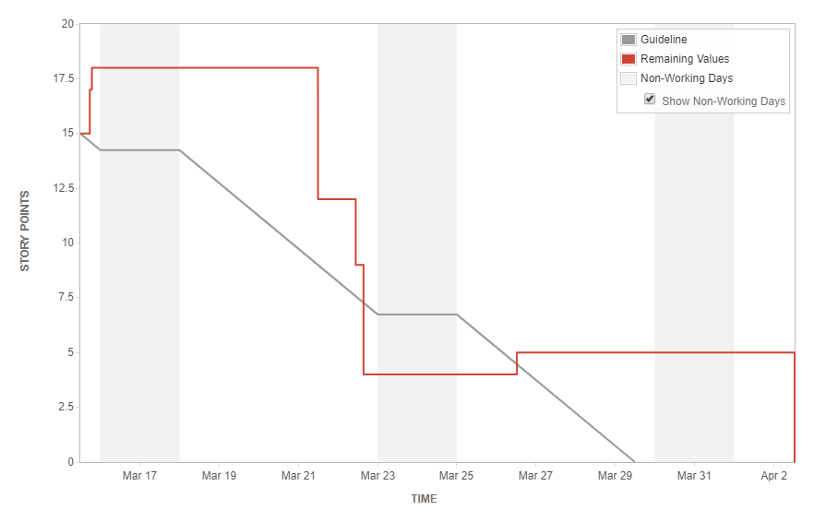
Burndown chart

Slide 9
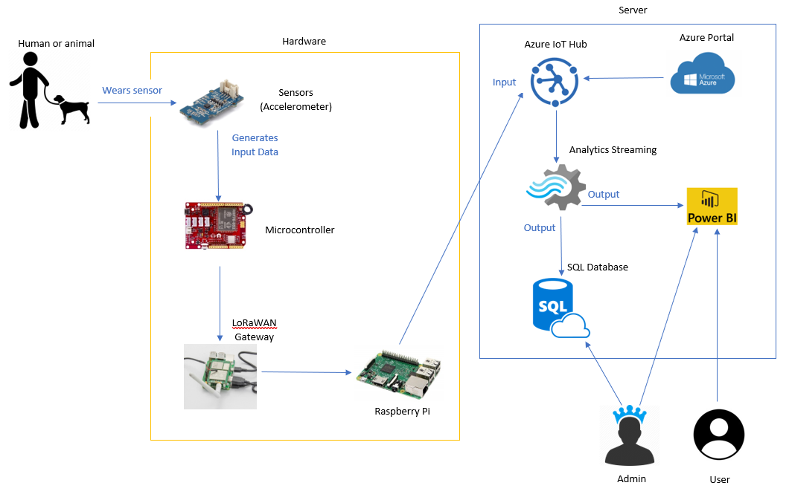
System Architecture

Slide 10
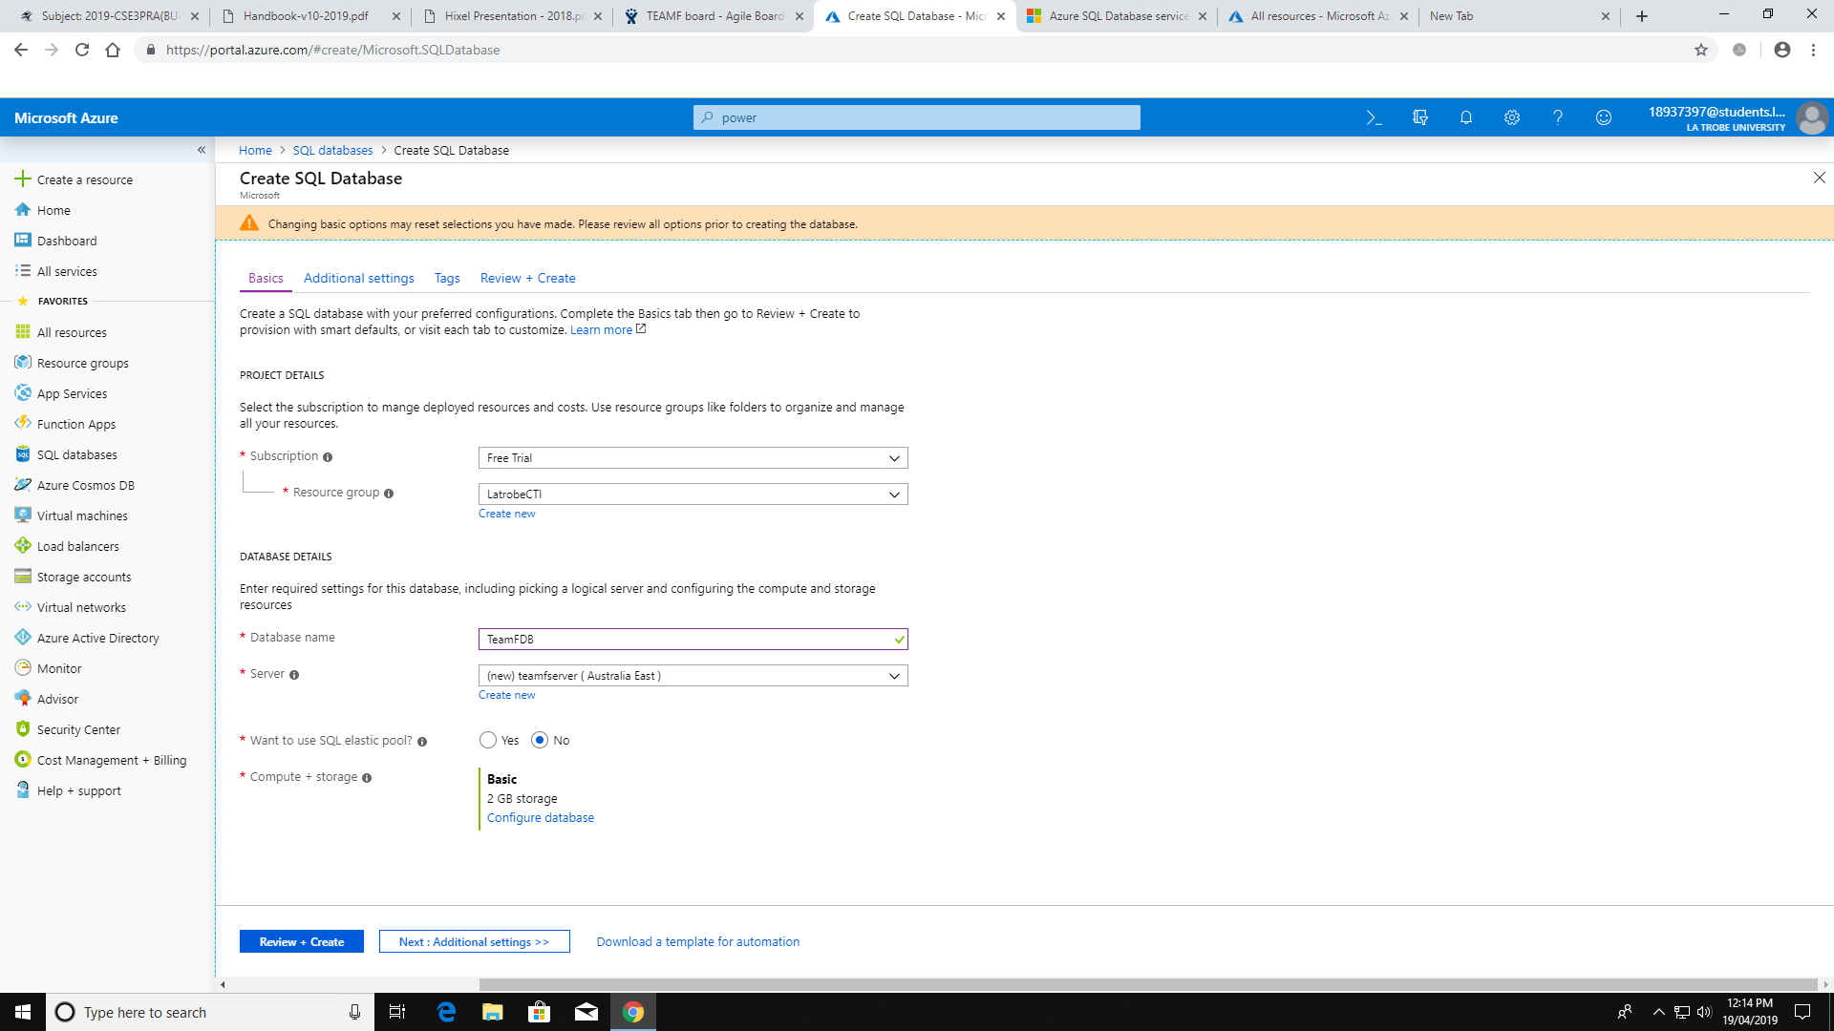
Sample Database

Slide 11
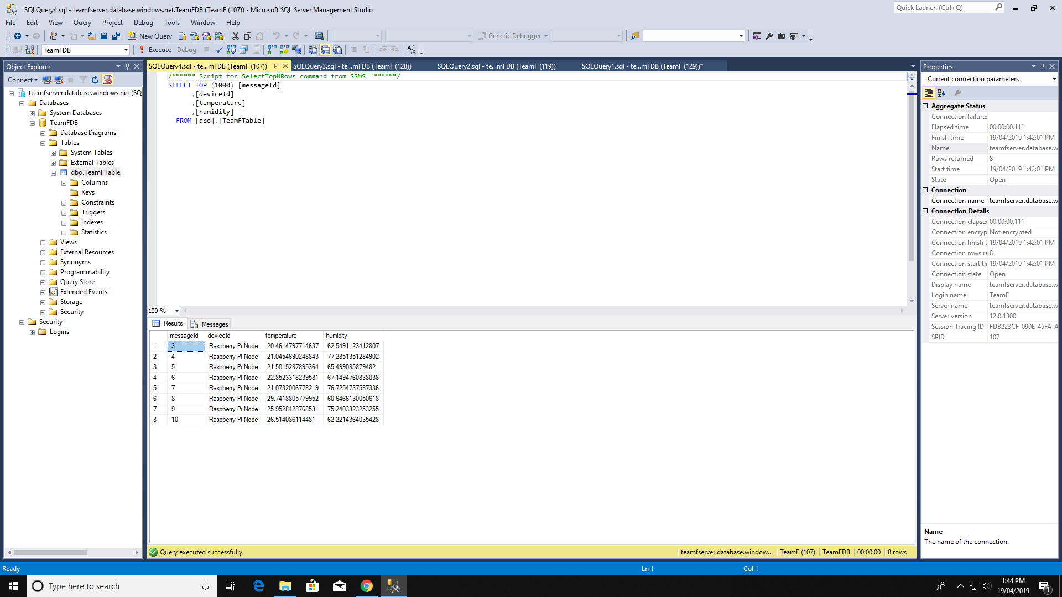
Sample Database

Slide 12
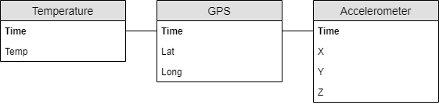
Final Database

Slide 13
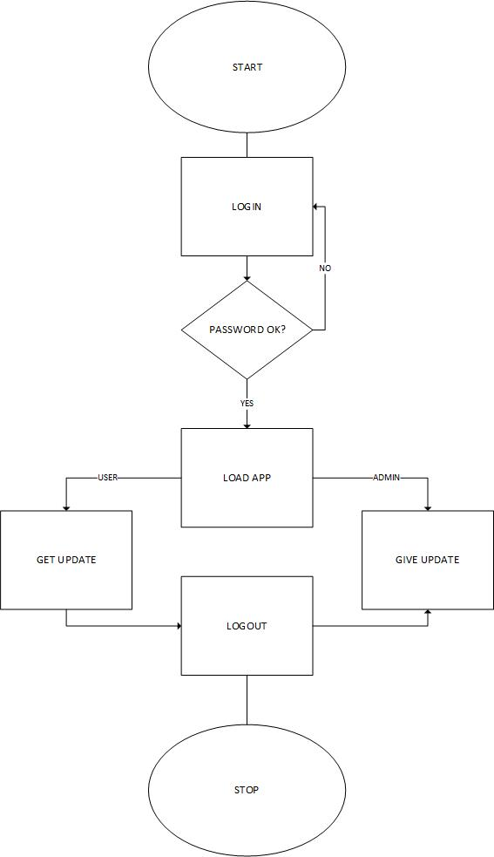
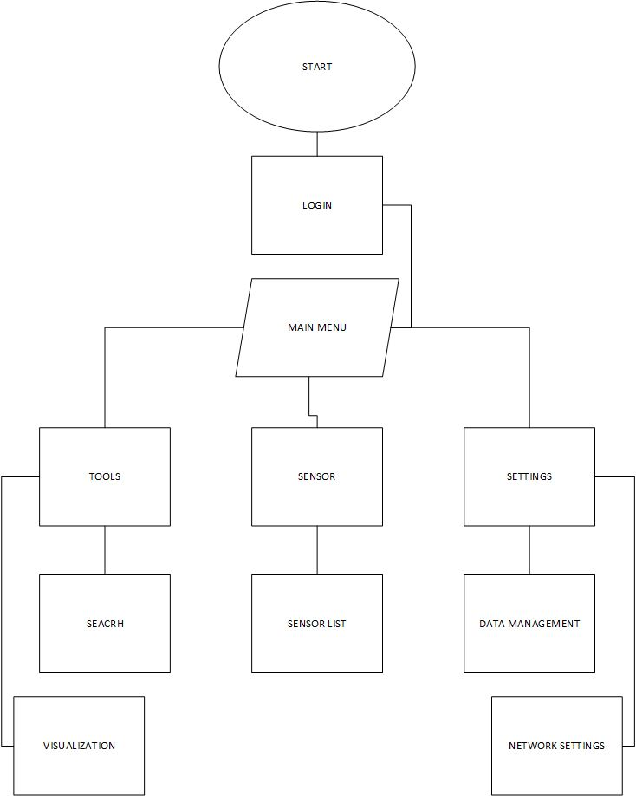
UI Prototype

Slide 14
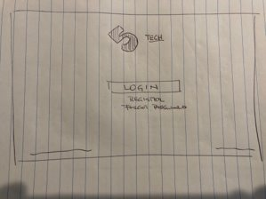
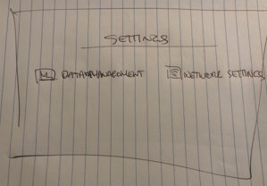
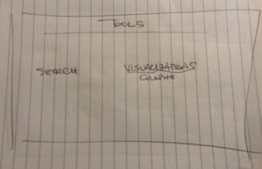
POWER BI WIREFRAME

Slide 15
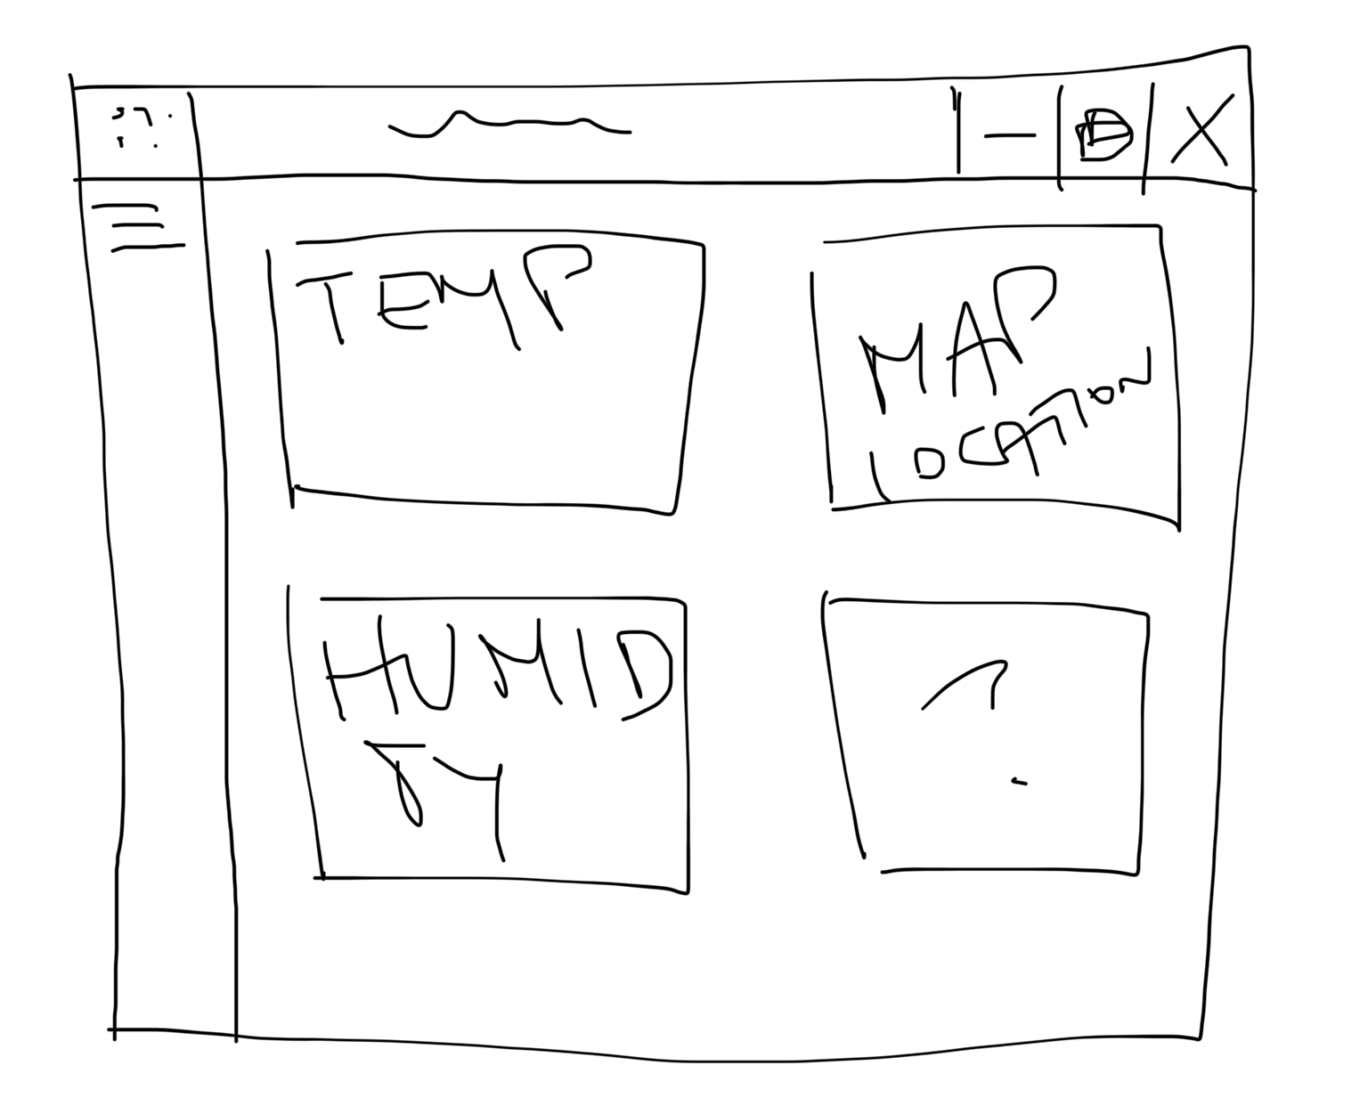
POWER BI WIREFRAME

Slide 16
POWER BI
Business Intelligence Platform
Analyzing, visualizing, sharing datasets. Reports, graphs, dashboards
Desktop, Android, iOS
Fast, easy to use, clean

Slide 17
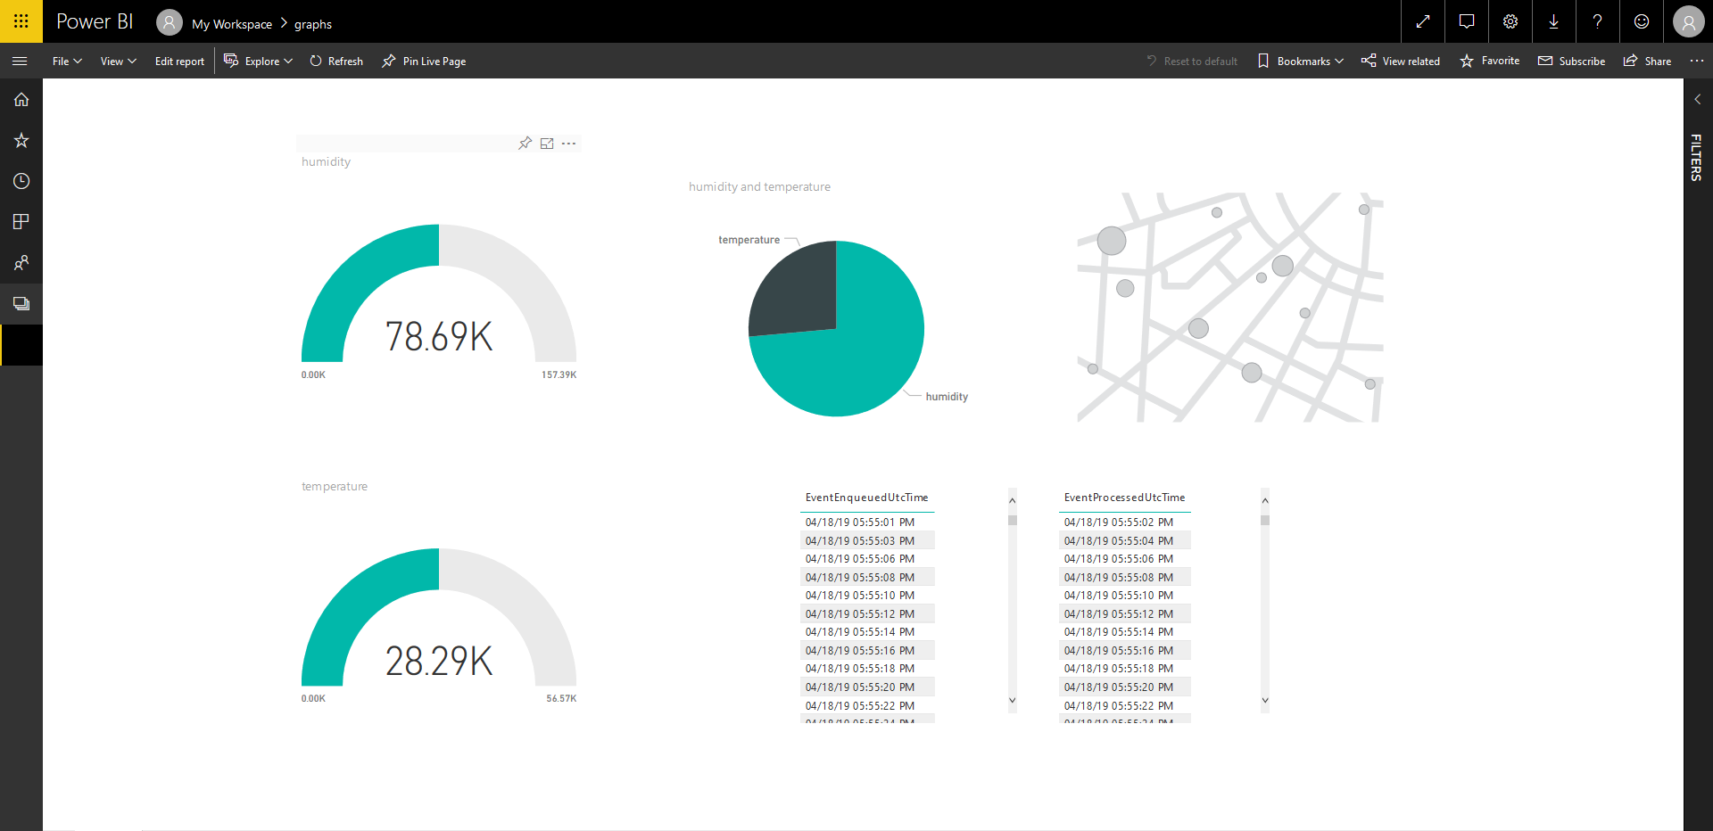
POWER BI UI

Slide 18
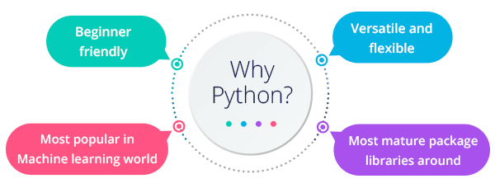
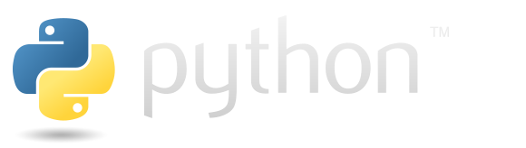
Python

Slide 19
Python
We have all looked into Python
Have practiced sample programs with Python
So far we have not done data analysis with Python

Slide 20
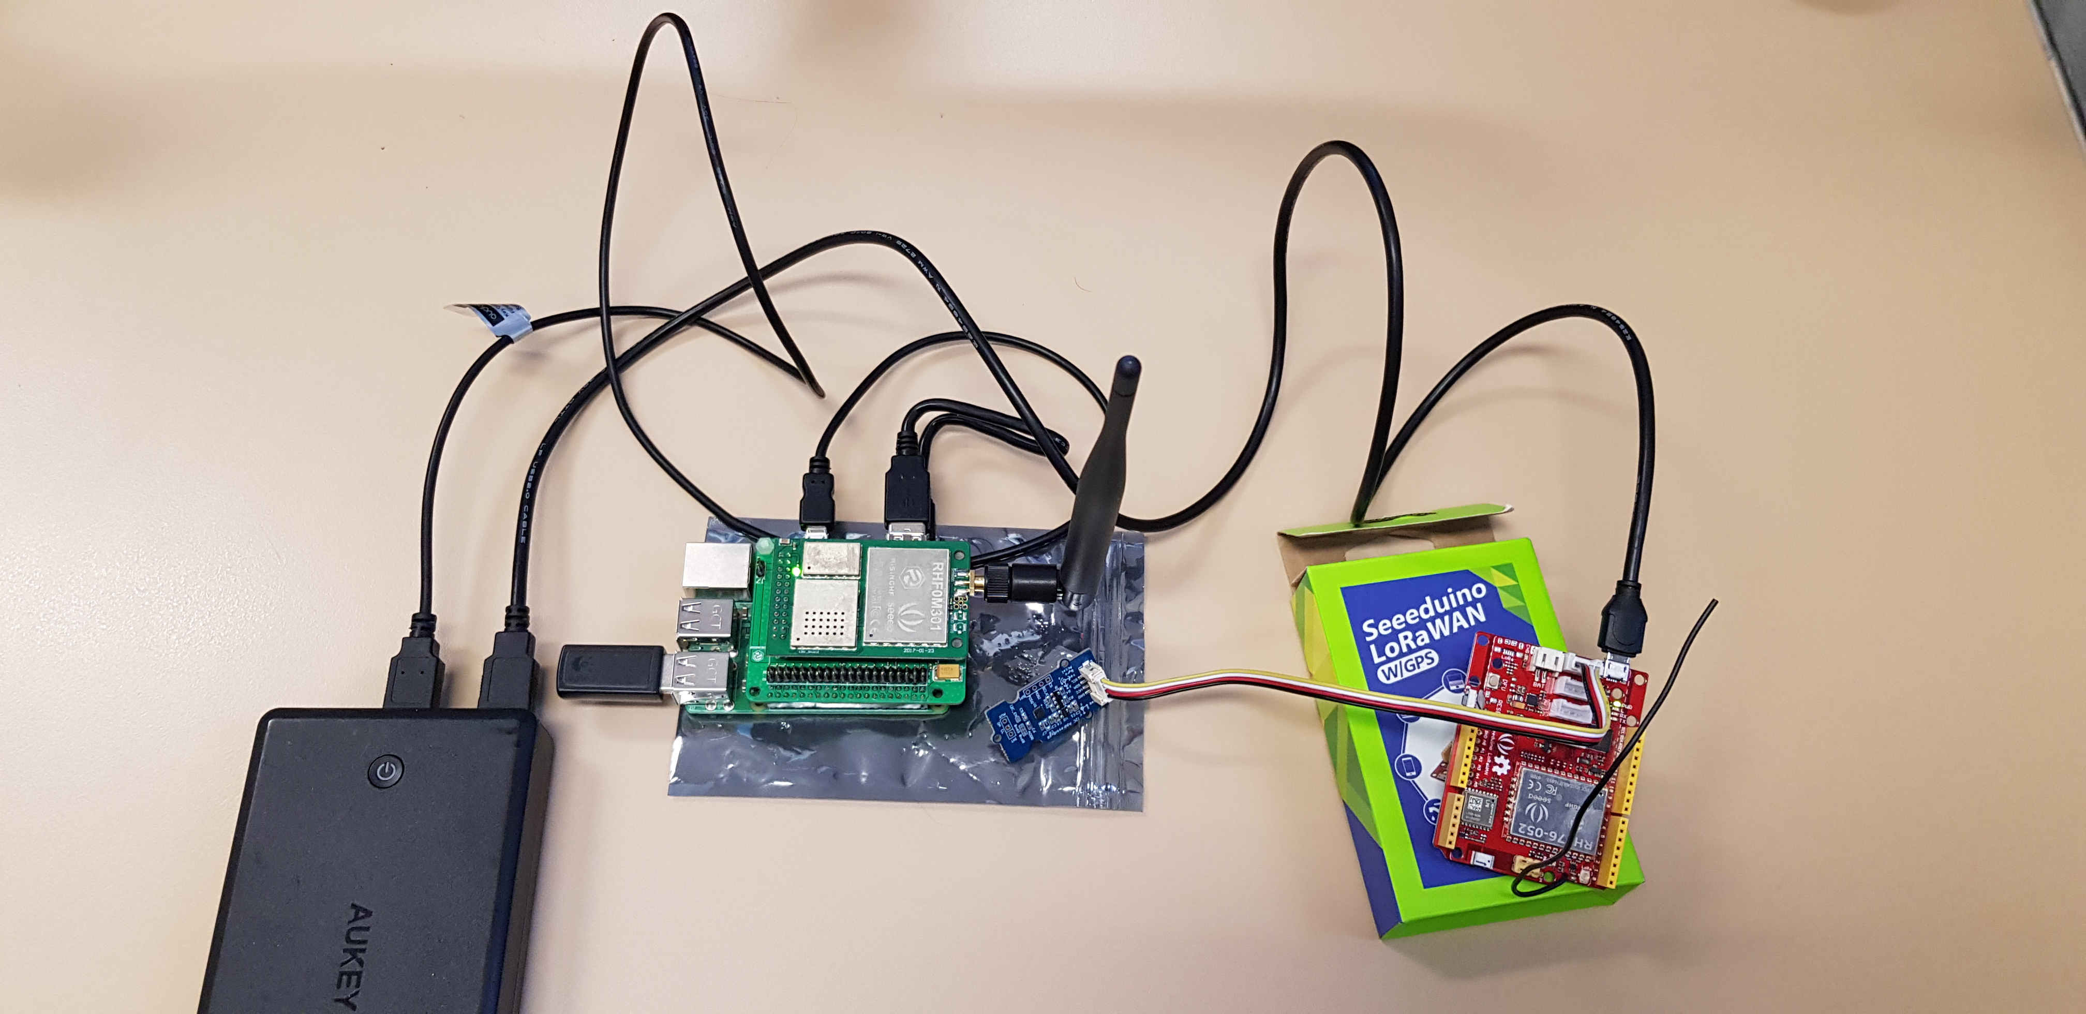
Hardware

Slide 21
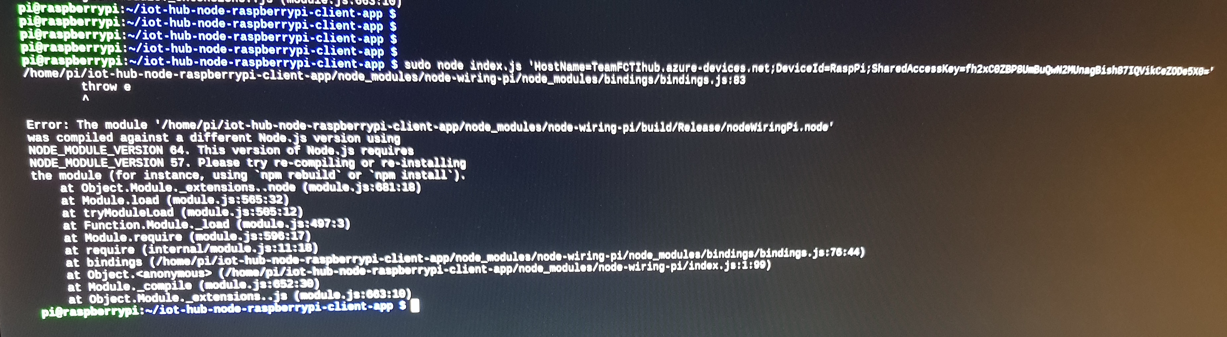
Failed STATE

Slide 22
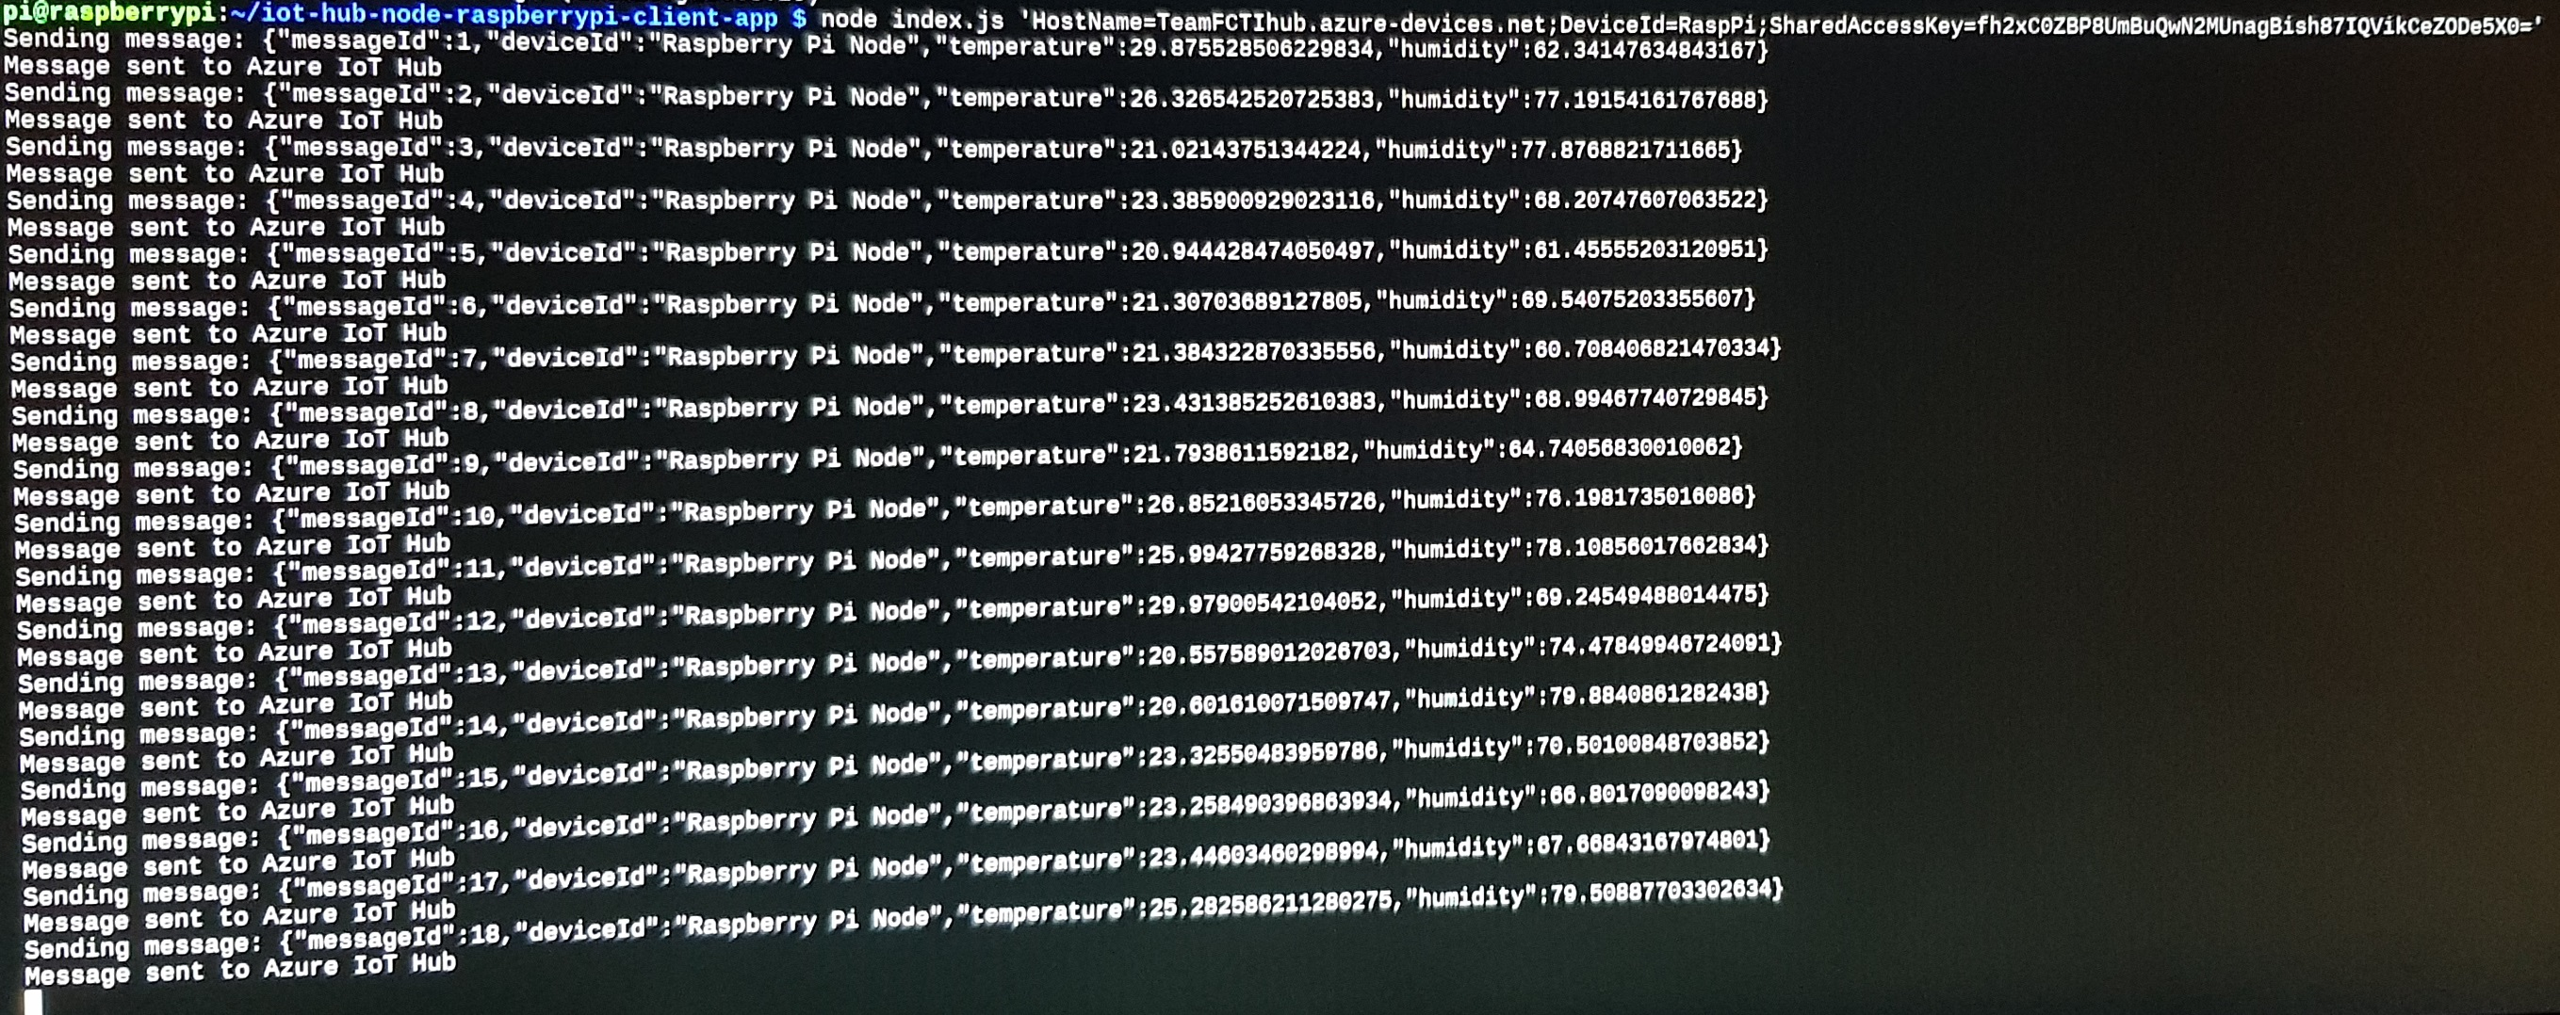
Working STATE

Slide 23
Sample Implementation / DEMO
We will now demonstrate the hardware running
Using the Pi, Azure and Power BI

Slide 24

Conclusion
Finish Setup of hardware and software
Get LoRaWAN starter kit project running on Pi
Use Python to analyse data
Improve physical design

Slide 25
Q&A

